Slide 1
Controlling the Quality of Property Valuation
Property Valuation Workshop
Izmir
February 28th – March 2nd, 2017
Ruud M. Kathmann
The Netherlands

Slide 2
Agenda
Netherlands
Netherlands Council for Real Estate Assessment
Valuation, the choices made over time
Taxation based on property value
Systems for automated? valuation models
Costs
Recommendations

Slide 3
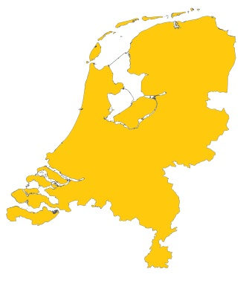
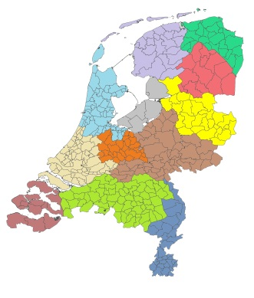

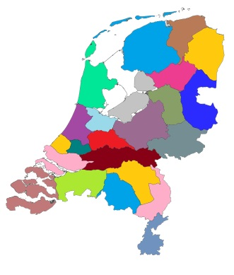
Netherlands
The Netherlands
12 provinces
388 municipalities
22 polderboards

Slide 4
Netherlands
16,7 million inhabitants
Capital Amsterdam (700.000 inhabitants)
Smallest municipality (1.000 inhabitants)
Area: 41,526 km²
7,6 million residential properties
150.000 sales per year
1,0 million non-residential properties
Total value: € 1.650 billion (€ 1.650.000.000.000)
€ 10 billion tax revenues based on the assessed value
Total costs for appraisal and assessment: € 150 million

Slide 5
Netherlands Council for Real Estate assessment
In Dutch: Waarderingskamer
Main task: quality control of mass valuation
Involved parties
  municipalities (390)
  polderboards (23)
  national revenue office
Board of Council board has 11 members
Staff 20 persons
Minister of Finance is responsible
Budget € 2 million (1,5% costs of valuation/assessment)

Slide 6
Act for Real Estate assessment: a short history
1970: Start of value based property taxes
1995: Start of Act for real estate assessment
1995: Start of Council for real estate assessment
1997: Property taxes bases on formal assessment
2007: Start of annual revaluations
2010: Start of multi purpose use of assessed values
2016: Start making assessed value residential property available for the public

Slide 7
Choice 1
Market value, the international definition (IVS and EVS)
1970: market value or area of property
    (taking into account value difference, eg building year and neighborhood)
    Area based system lost its use because of court decisions
1995: market value (act for real estate assessment)
    Based on full ownership and ready for use
    Highest and best use (allowed by zoning regulations)
    No seperation between land and buildings
    Sales comparison for residential, capitalization of rent for commercial
    Reproduction costs for non marketable properties

Slide 8
International valuation Standard (IVS)
Market value
  The estimated amount for which a property should exchange on the date of valuation between and willing buyer and a willing seller in an arm's-length transaction after proper marketing wherein the parties had each acted knowledgeable, prudently, and without compulsion.

Slide 9
Choice 2
Annual revaluations (market reference date one year before)
    2017 assessed value based on market of 1 January 2016
1970: revaluations at least every five year
1995 four year revaluation (reference date two year before)
2007 annual revaluations
    Efficient working procedures
    No large value difference between revaluations (objections)
    Recent value usable for a larger number of puposes

Slide 10
Annual valuation

Slide 11
Annual valuation

Slide 12
Choice 3
Separation between valuation and tax policy
Valuation on (100%) actual market value
Each level of government responsible for its taxation
    Setting rates, sending tax bills, collecting money
Municipal council
    90% of financial means from central governm., 10% municipal tax
    Tax rate owners residential, owners non-residential, users non-residential
    Tax rate calculated from municipal budget divided by total value
    Can exempt specific type of properties
National discussion
    Lower national income tax and increase local property tax

Slide 13
Average tax bill:
Value | Tax | Tax rate | Tax bill
€ 250,000 ($ 336,000) | Municipal real estate tax | 0.2% | € 500 ($670)
 | Real estate tax Polderboard | 0.05% | € 125 ($ 170)
 | Income tax (imputed income owner-occupied house) | 0.60%*0.42% | € 630 ($ 770)
 | Total tax bill |  | € 1,255 ($ 1,610)

Slide 14
Choice 4
Municipalities are responsible for valuation/assessment
Central valuation by national revenue office considered
Advantages municipalities
    Data about real estate because of building permits, zoning, etc.
    Closest to the properties (for physical inspections)
    Closest to the public
Scale of municipalities a problem?
    Not for larger municipalities
    Smaller municipalities outsource to specialized private firms (at start)
    Smaller municipalities organize shares service centers (now)

Slide 15
Data used for valuation
Cadastral information
  ownership
  plot size
Registration of buildings
  residential or not, size and building year
  building activities
Data collection for valuation
  type of building, quality of materials, maintenance situation, garages, etc.

Slide 16
Choice 5
Independent quality control
Fairness for taxpayers living in different municipalities
Because tax offices must rely on correct assessed value
Therefore Council for Real Estate Assessment
Our main quality criteria:
    Complete
    Correct (on market level and correct mutual relations)
    In time

Slide 17
Quality control
Set out guidelines
  administration
  valuation
  quality control procedures
Perform audits
Publish results

Slide 18
Choice 6
Complete system of objections and appeals
If value considered incorrect: objection to municipality
    Reconsideration/revaluation of the property
Appeal at three layers of court
    Court
    Court of appeal
    Supreme court
But we encourage informal contact instead of formal objections

Slide 19
Appeal
In 2016 there were:
  1,6% appeals (100.000) for municipalities
In 2015
  about 10.000 cases in court
Council for real estate assessment is not involved in appeal procedures
About 25% of total costs for appeals

Slide 20
Choice 7
Valuation report for taxpayer
Assessed value must be explained to taxpayer
  To avoid misunderstanding / to avoid objections
  Valuation report on paper when asked for (at start)
  Valuation report available on internet (secured by login)
  Valuation report must be understood by taxpayer
  All values of residential property available
Informal contact with municipality (valuer)
Taxpayer helps municipality to update information
  Win-win: better information and higher trust

Slide 21

Valuation report
Property location
Street: ……………
Number: ……………
Residence: ……………
Address
Cadastral information
Municipality: Parcel number: Size:
…………… …………… ……………
…………… …………… ……………
Cadastre
Object characteristics
Type: ……………
Building year: ……………
Size: ……………
Special characteristics:
..............................
Buildings
Market data
The appraised property is sold:
Market data
Selling date: Selling price: Special circumstances:
…………… …………… ……………
Other relevant market data:
Street: ………
Number: ………
Residence: ………
Type: ………
Building year: ………
Selling date: ………
Selling price: ………
Assessed value: ………
Street: ………
Number: ………
Residence: ………
Type: ………
Building year: ………
Selling date: ………
Selling price: ………
Assessed value: ………
Street: ………
Number: ………
Residence: ………
Type: ………
Building year: ………
Selling date: ………
Selling price: ………
Assessed value: ………
Comparables
Assessed value: € ………
Value

Slide 22
Choice 8
Increase official use of formal assessed value
Efficiency: same costs, more revenues
As much taxes as possible
    Not only property tax, but for instance als inheritance tax
Prevent fraud on sales or mortgages
Set maximum rent price for social housing
But also informal use of assessed value
    Insurance companies ask assessed value from there clients

Slide 23
Taxation based on property value
Municipalities
    Real estate tax for owners (residential and non-residential) and users (non-residential)
    Municipal council sets tax rate (residential average 0,15%)
    Tax bill in January or February (includes other taxes and duties) and formal assessment of value
Polderboards
    Real estate tax for owners of built up properties
National revenue taxes
    Imputed income as part of Income Tax (owner occupied)
    Landlord tax
    Inheritance tax

Slide 24
Systems automated valuation models
8,6 million valuations each year need automated tools
Systems developed my market competition
  5 -7 specialized firms that sell these systems to municipalities
Special for demands in the Netherlands
  Automated valuation reports
  Value on market level (for individual property)
  More often based on clustering of groups than on MRA
  Individual corrections on calculation made by model

Slide 25
Costs of assessments
Costs around € 150 million per year
    € 17,- per property per year
    80 – 90% salary of staff and overhead
Cost of valuations:1,5% of tax revenues
Other costs property tax: 4,5% of tax revenues
Costs valuation include:
  Updating and quality control data (30%)
  Market analysis, optimizing valuation model, controls (30%)
  Objections and appeals (30%)
  Rest (10%)

Slide 26
Recommendations
Earn trust of taxpayers (fair, understandable, transparant and influence)
Try to limit the number of exemptions in the tax system
Annual valuation of market value, many advantages, but you have to grow into the system
Clear expectations of valuations: a good model is not the same as good individual values
Buying a tool doesn’t make valuation models
Valuation model is important, but good data (object-characteristics, market, etc.) are much more important

Slide 27
Questions and discussion
Any questions
Now, or:
  r.kathmann@waarderingskamer.nl

