Slide 1



GENERAL DIRECTORATE OF LAND REGISTRY AND CADASTRE
Property Valuation Workshop
Izmir
27 February – 3 March 2017
Property Valuation and Taxation for Fiscal Sustainability in the Europe and Central Asia Region
Richard Grover
rgrover@brookes.ac.uk

Slide 2
Merits of recurrent value-based property taxes
Suitability as local taxes as fall on immobile assets – it is clear which assets fall within a jurisdiction
Reduces local governments’ dependency on inter-governmental fiscal transfers at a time when many governments are under fiscal strain
Increases accountability of local governments to citizens
Helps to counter tax avoidance by multi-national companies and tax erosion resulting from globalisation – profits can be reduced by transfer pricing but property cannot be hidden
Reduces reliance on income, profits and sales taxes and social security contributions and their distorting effects on work and investment
Taxes wealth – helps promote equity in taxation by reducing tax burden on low income groups coming from income and sales taxes
Helps counter inter-generational wealth inequalities

Slide 3
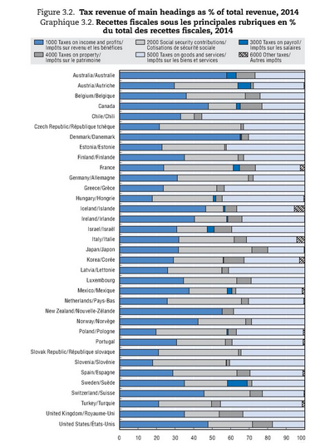
Turkey has relatively high dependence on sales taxes and relatively low use of income and property taxes
Source: OECD (2016), “Tax levels and tax structures, 1965–2015”, in Revenue Statistics 2016, OECD Publishing, Paris,
DOI: http://dx.doi.org/10.1787/rev stats-2016-6-en-fr

Slide 4
Property taxes as percentage of Gross Domestic Product (GDP)
Turkey 1.4%
OECD average 1.9%
Turkey below average use of property taxes
Source: OECD (2017), "Revenue Statistics: Comparative tables", OECD Tax Statistics (database).
DOI: http://dx.doi.org/10.1787/data-00262-en

Slide 5
Recurrent property taxes as percentage of GDP
Turkey 0.3%
OECD average 1.1%
Turkey significantly below OECD average
Source: OECD (2017), "Revenue Statistics: Comparative tables", OECD Tax Statistics (database).
DOI: http://dx.doi.org/10.1787/data-00262-en

Slide 6
Taxes on financial and capital transactions as percentage of GDP
Turkey 1.1%
OECD average 0.4%
Turkey significantly higher than OECD average.
Issue of distorting impact of property transfer taxes on property market
Source: OECD (2017), "Revenue Statistics: Comparative tables", OECD Tax Statistics (database).
DOI: http://dx.doi.org/10.1787/data-00262-en

Slide 7
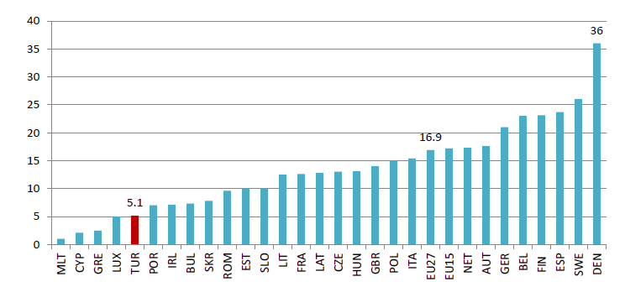
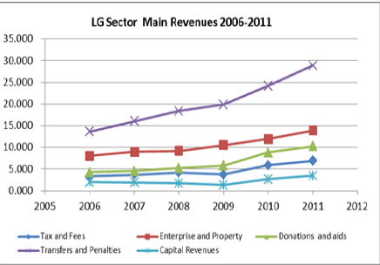
Sub-national expenditures as a percent of GDP, 2010: Turkey and EU
Local government expenditure is low relative to European norms
Local administration sector heavily reliant on transfers, government aid and donations.
Enterprise and property sales dominate municipalities’ own source revenues
Taxes and fees are relatively unimportant.
Is this sustainable as urbanisation slows down?
Source: World Bank (2014), Rise of the Anatolian Tigers: Turkish Urbanization Review, Report Number 87180-TR

Slide 8
So where do the problems lie – and can they be overcome?
World Bank/ FAO knowledge project in 2014/15
9 case studies: Albania, Kazakhstan, Lithuania, Moldova, Netherlands, Poland, Serbia, Slovenia, Turkey from Europe and Central Asia Region
Case studies published in Land Tenure Journal, Issue 2/2015 (2016), http://www.fao.org/3/a-i5429t.pdf
Range of countries from those who had implemented successful value –based property tax reforms to those experimenting with pilot studies
Lithuania successful introduction – Moldova good system but roll out incomplete and no revaluations - Slovenia and Poland good systems but implementation blocked – Serbia, Turkey, Albania and Kazakhstan at various stages in experimenting with mass valuation
Role of the Netherlands as a control – successful system of value-based property taxation with annual revaluation and multiple usage of assessments by public bodies – devolved assessment by municipalities with standards set by central body

Slide 9

Land Tenure Journal, Issue 2/2015 (2016)
Thematic issue on property
valuation and taxation in Europe
and Central Asia
http://www.fao.org/3/a-i5429t.pdf
Tuğba Güneş and Ümit Yildiz (2016), “Property Valuation and Taxation for Improving Local Governance in Turkey”, pp. 141-160

Slide 10
Influences on use of property taxes suggested by literature:
Income level
Extent of urbanisation
Openness of economy
Legal heritage
Degree of decentralisation in government
Focus in our study on how governments and donors may be able to change usage of value-based property taxes and overcome barriers rather than cultural/ legacy issues influencing usage

Slide 11
Principal findings
World Bank/ FAO Knowledge Project, Property Valuation and Taxation for Fiscal Sustainability and Improved Local Governance in Europe and Central Asia

Slide 12
Importance of quality of property registration
Need for comprehensive register of properties – issues of systematic first registration, informality, voluntary registration of transfers, registration of leases
Register of 3-dimensional rights and not just parcels or buildings – units of occupation rather than ownership, ancillary spaces and rights
Characteristics and attributes of properties are recorded – unreliable and inconsistent data can be declared about property characteristics such as size – footprint rather than floor area, terraces excluded
Maintenance of currency of register – use of automatic updating and data capture where possible
Turkey: issue of informal housing and construction not being in tax rolls and consistency in recording data about property

Slide 13
Importance of quality of price data
Need for source of accurate price data as basis for estimating market prices eg declared prices on registration
Need for efficient and transparent markets with adequate numbers of transactions of each type of property
Problem of tax evasion and declaration of false prices – incentives to cheat to avoid taxes and fees
Weak tax enforcement mechanisms undermine data quality
If declared transactions prices unreliable can use alternative such as asking prices, mortgage valuations, databases of valuers and realtors
Development of sales price, rental and mortgage valuation registers to improve transparency and reliability of data
Turkey: Inaccurate reporting of transaction prices due to level transactions fees (4%) and valuation register not yet available

Slide 14
Valuation infrastructure: a necessary pre-condition
Adoption of internationally-recognised valuation standards and creation of a valuation profession:
  Valuation terminology and valuation framework
  Valuation methodologies
  Measurement standards
  Qualifications, education and experience required of valuers
  Enforceable ethical standards and codes of professional conduct
  Licensing of valuers or requirement to use valuers who follow valuation standards
Turkey: Capital Markets Board regulates mortgage and asset valuations. Adoption of International Valuation Standards. TDUB regulation of valuers and use of. System is not used for property tax valuations

Slide 15
Quality of tax collection
Quality of billing systems
Variability in collection rates and in enforcement systems
Differences between household and business collection rates
Overcoming culture of non-payment
Transparency issues: are the elites paying their taxes?
Turkey: Issue of informal housing and construction – pilot studies by Güneş and Yildiz (2016) show discrepancies of 2.9 and 1.9 times between current and estimated property tax and 2.5 and 2.1 times for transaction fees.

Slide 16
Use of mass valuation
Large number of properties to be valued over a short period of time – viable only with automated valuation systems rather than individual valuations
Use of standardised procedures, common data and statistical testing of models – helps achieve consistency
Requires coordination of different agencies and their data
Low cost per valuation but high fixed costs of establishing the system
Tackles capacity problems - reduces requirements for scarce skilled valuers who can be used more effectively such as hearing appeals, valuing properties for which automated valuation not possible, reviewing data and models

Slide 17
Multiple use of mass valuations spreads costs and encourages confidence in use
Avoids duplication of effort by different agencies/ levels of government
Helps to recoup costs of mass valuation
Standardised systems to ensure reliability, transparency and consistency
Need for regular revaluations so values are up to date
Uses include: sporadic tax assessments, compulsory purchase, valuing state land, restitution, land consolidation, water and flood protection charges, setting rents for social housing, reviews of bank capital adequacy, avoidance of mortgage fraud, eligibility for social security
Caveats:
  mass valuations may not accurately value individual properties
  Embody assumptions about basis of value
  Compulsory acquisition particularly problematic
  Need to avoid “black box” methods

Slide 18
Overcoming resistance to property taxes
Poland and Slovenia have developed mass valuation systems that have not been implemented: Poland no implementing legislation; Slovenia ruling by Constitutional Court.
Moldova mass valuation of urban properties but no revaluations. No mass valuation of rural housing or agricultural land or public properties as no systematic first registration has taken places
Assessing residential properties technically easier but there is likely to be more resistance than to taxing commercial properties – business don’t have votes!
Property taxes highly visible as are local services – need for public support
Lack of effective champions in government – local taxes, different administrative systems from other taxes, failure to recognise the financial interdependence of levels of government
Lack of political willingness to tax wealth and to stand up to losers from property taxes
Need to make the link between sound national finances, sound local finances and the quality of local public services

Slide 19
Conclusions
Development of effective and efficient value-based property taxation a long-term goal
Likely to require several iterations – successful innovators did not do this in one go
No universally applicable model – need one that reflects individual circumstances, culture and values – but common challenges for all countries
Sensible to focus first on higher yielding properties such as grade A offices, shopping malls, luxury villas rather than mass housing and agricultural land
Some one-off improvements can be made to yields through more comprehensive tax rolls and better collection methods
Sustainable growth in revenue requires value-based property taxes with regular revaluations to capture uplift in property values

