Slide 1
International Experience with Organizing Property Tax & Valuation Systems
Richard Almy

Slide 2
Background
Types of property taxes
Recurrent taxes
IMF has X categories
example: an annual real estate tax (land taxes, building taxes, real estate taxes, combinations)
Sporadic taxes
IMF has Y categories
Main one is taxes on transfers of property
Value & valuation concepts
“Value” is subjective—an opinion
Value depends on what is being valued & on what the valuation will be used for—taxation, for example
Valuation credibility & valuation standards
Notes:
Some basic points so that you can better understand me.
Note reference to standards at bottom. Potential redundancy

Slide 3
Valuation for Taxation
Should be cost-efficient
Adam Smith’s 4th canon
The Swedish concept of “ambition”
Value at risk (taxes at issue in an appeal)
Reliance on “mass valuation”
Assessed (cadastral) values should have a presumption of fairness, which can be challenged with appropriate evidence
Mechanisms for challenging mass values should be commensurate with ambition
Values should be perceived to be plausible and fair
Notes:
Every tax ought to be contrived as both to take out and keep out of the pockets of the people as little as possible, over and above what it brings into the public treasury of the state

Slide 4
What Do We Know About Costs?
Opinion: property tax administration—from assessment through collection—should cost no greater than 10% of revenues. 2-5% is reasonable for many countries.
Factors: Level of taxation (effective tax rate) and complexity of the property tax system; development patterns & property markets; valuation methods
Achievements:
Lithuania: Mass valuation budget of €660,000, about 0.6% (€1 per property vs. €100 for a conventional valuation).
Netherlands: Valuation about 1% (€18 per property)
Northern Ireland: 2005 revaluation: about ₤15 per property
Spain: 2001 revaluation of Madrid: €13 per property
United States (sample): Valuation about 0.8% (median: $23 per property vs. $350-$500 for a conventional valuation). Revaluation cost: About $50 per property

Slide 5
Mass Valuation
“The process of valuing a group of properties as of a given date, using standard methods, employing common data, and allowing for statistical testing.” (IAAO)
Processes—see figure
Valuation “models”
Types of models
Simple, per-unit models
Table-based models
Multivariate statistical models
Combinations

Slide 6
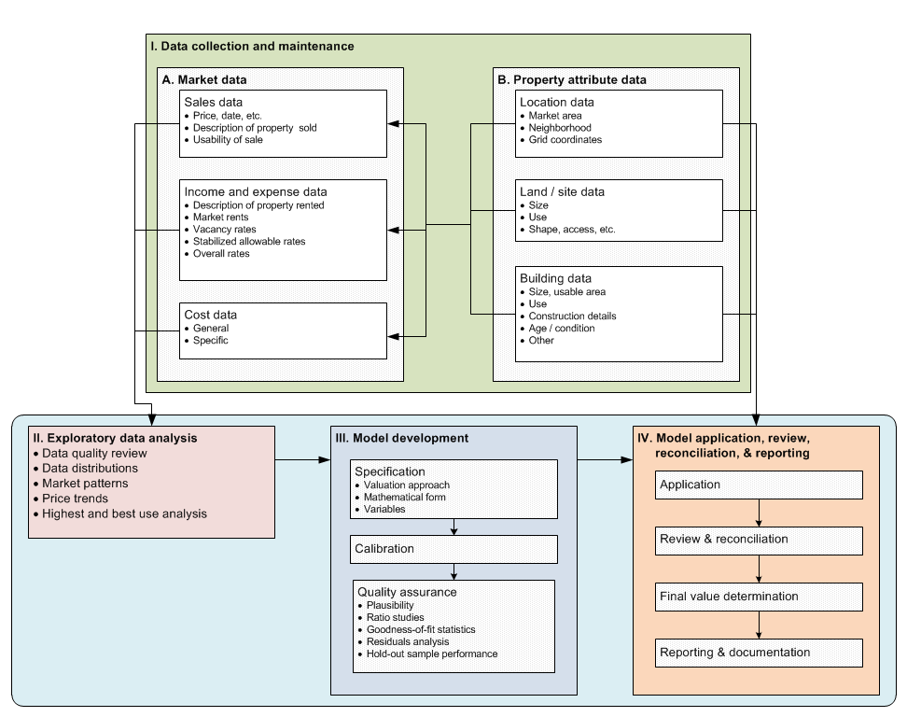
Mass Valuation System
It all begins with data!

Slide 7
Valuation System Requirements
Market conditions
Legal framework
Management & organization
Technology
Competent staff

Slide 8
Market Conditions
Private rights to own or use property
Protections
Of rights
Against corruption
Active selling & buying
Property professions & institutions
Agents
Valuers
Lenders

Slide 9
Legal Framework
Value standard (definition & assumptions)
Access to market data
Guidance on valuation methods
Revaluation requirement
Publicity and appeals
Absence of laws and practices that undercut the goal of an efficient & effective valuation system

Slide 10
Organizational Issues
Responsibility assignments
Data flows between valuation agency and (as applicable):
Title cadastre (including price information)
Planning & permitting agencies
Others
Quality assurance & oversight
Effective leadership

Slide 11
Organizational Structures for Valuation
Tier of government responsible for valuation
Central government
Local government
Mix
Location in governmental structure
Part of property tax administration
Part of cadastre
Independent valuation organization (UK)
Government corporation (Canada, Lithuania, New Zealand, etc.)
Oversight
Neglected in many countries
Good examples of oversight: Netherlands, New Zealand
Notes:
Problems & Lessons?

Slide 12
Patterns
Level of Government Responsible for
 | Fiscal Cadaster |  | Valuation System
 | Number | Percent | Number | Percent
Central | 38 | 73 | 51 | 45
Regional | 0 | 0 | 5 | 4
Local | 3 | 6 | 29 | 25
Mixed | 11 | 21 | 29 | 25
Total | 52 | 100 | 114 | 100
Type of Cadastral Agency
 | Number | Percent
Standalone Cadastral Agency | 20 | 57
Multipurpose Cadastral Agency | 12 | 34
Other | 3 | 9
Total | 35 | 100
Type of Agency Responsible for Valuation
 | Number | Percent
Cadastral Agency | 17 | 20
Revenue or Tax Agency | 50 | 58
Standalone Valuation Agency | 14 | 16
Mixed | 5 | 6
Total | 86 | 100
Source: Author

Slide 13
Technology
System components
Database management system
Property identification system (PIN)
Computer-assisted mass appraisal (CAMA) system
Geographic information system (GIS)
Tax administration
Integration/inter-operability
Security

Slide 14
Processes
Collecting and maintaining data on properties and their attributes
Collecting market evidence (indicators of value, such as sales prices, rents, etc.)
Market analysis (trends in prices across time and among locations and types of properties)
Developing and applying mass valuation models
Evaluating value accuracy (ratio studies) of current and proposed values
Communicating values to tax authorities, taxpayers, and other stakeholders
Responding to appeals and other objections about values.

Slide 15
Sales Data Collection & Processing
Mandatory disclosure of sales prices, etc.
Measures to encourage accurate disclosures
Low transfer taxes
Capital gains taxes
Other
Screening of sales to determine usability
In valuation
In performance analysis (ratio studies)
The questions to answer
Maintenance of a sales file (register)
A record for each transfer
Each record contains facts about the transfer and details about the property a the time of transfer
Special issue—multiple-property transfers
High (>2%?) transfer taxes & fees are always a problem
Important technical feature!
Notes:
May need to split

Slide 16
Screening Sales
Goal: a sufficiently large, representative sample of bona fide sales
Questions:
What was sold and when?
Does the declared price seem reasonable?
Is the sale usable in analysis?
How many sales are needed?
It all depends on the market
Benchmarks: 200+ (5+ per variable)
Develop usability codes so that exclusions are documented
Trimming of “outliers”

Slide 17
Collecting & Maintaining Attribute Data
Data Needs
Determination of Data To Collect
Valuation
Use
Location
Size
Quality & age
Features
Tax administration
Exemptions
Differential rates, etc.
Other purposes
Be economical
Usually < 20 characteristics is sufficient
Consider ease of collection
Collection Methods
Field inspections
Taxpayer declarations
Imagery
Combinations
Notes:
Declarations: Slovenia, Sweden, Turkey, Indonesia, and Russian Federation

Slide 18
Modeling Strategies
Simplicity (Denmark, Sweden)
Stability
Market-centered (“base home”) models (Denmark, Iceland)
Find the most common, representative property types and features
Find typical prices for these properties
Find out how prices rise and fall from representative properties based on changes in attributes

Slide 19
Selected Cases
Denmark: Longstanding use of explainable mass valuation models; short revaluation cycle
Iceland: Progressive reforms in mass valuation system, first residential then commercial property models
Lithuania: Well-managed organization, phased approach to reforms; use of multivariate models developed by regional valuation staff (with central support)
Netherlands: Locally administered valuation, assisted by consulting firms, and supervised by central government; sophisticated communications with taxpayers
New Zealand: Materials for auditing valuations produced for local governments, often by consulting firms
Spain: A large county with a centralized valuation system

Slide 20
Staffing
US Benchmarks
Overall valuation (assessment) office staffing: About 1 employee per 3,000 properties
Analysts
Qualified valuers: About 1 per 8,000 properties
I have developed an Excel spreadsheet that could be adapted.

Slide 21
Professional Standards
IVS
IAAO
IVS-101 Scope of Work
Mass valuation now somehow subsumed under general standards—no specific guidance
Compliance based on peer acceptance
Standard on Mass Appraisal of Real Property
More
Guidance on International Mass Appraisal and Related Tax Policy
Objective measures of overall valuation accuracy
Notes:
Principles and …

Slide 22
Data Access & Taxpayer Assistance
Principle: Make as much data public as possible
Website—increases trust in taxation & credibility of valuations
Valuation register
Sales register
FAQs
Mass valuation report (US Uniform Standards of Professional Appraisal Practice (USPAP))
Individual valuation reports (Netherlands)
Market analyses (Hong Kong, Baltic countries)
Delinquent taxpayer register?
Of course, the ability to talk to a person is important!

Slide 23
Some Strategies for Sustainability
Increase cost-effectiveness by designing the system to serve multiple valuation & property information purposes (remembering that a value for one purpose is not the value for all purposes)
Focus on the needs of clients
Notes:
Custodians, not owners of data

Slide 24
Uses of Cadastral Values
Recurrent property taxes
Transfer taxation (Denmark, Iceland, Lithuania, Netherlands, & Sweden)
Net wealth taxation (Austria & Switzerland)
Capital gains taxation (Finland)
Imputed income from owner-occupied property (Italy & Netherlands)
Other (mortgage finance, fire insurance, expropriation)

