Slide 1
Establishing a Mass Valuation system: the experience of Slovenia
Izmir, Turkey,
27 February - 3.March 2017
Neva Žibrik, MSc
Neva.zibrik@mf-rs.si
Ministry of finance, Republic of Slovenia

Slide 2
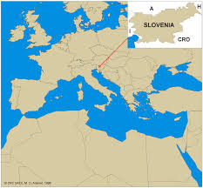
Population: 2,1 million
Area: 20.273 km²
Levels of government:
- central
- local (212 municipalities)

Slide 3
Situation before the development of mass valuation:
- Slovenia declared independence in 1991
- Privatization enforced in 1991
- Complete land book (ownership of all land)
- Complete land cadastre (parcels)
- No building cadastre

Slide 4
REAL PROPERTY TAXATION
LOCAL GOVERNMENT (all taxes are levied and collected by central tax authority):
1. TAX ON (IMMOVABLE) PROPERTY
2. CHARGE FOR THE USE OF BUILDING LAND
3. TRANSFER TAX (in SLOVENIA: 2 %)
4. INHERITANCE AND GIFT TAX
CENTRAL GOVERNMENT:
5. VAT
6. INCOME TAX ON CAPITAL GAIN

Slide 5
RECURANT TAXES ON REAL PROPERTY
 | TAX ON (IMMOVABLE) PROPERTY | CHARGE FOR THE USE OF BUILDING GROUND
Tax object | buildings, parts of buildings, apartments, garages, business premises | Building land and buildings
Evidence | tax register (central) | municipal register (local)
Tax payer | physical persons | physical and legal persons
Tax base | Administrative value (no. of points X value of points) | /
Tax rates | In the law: 0,1 – 1,25 (progressive) | Rates set by municipalities
Exemptions | residential property of less than 160 m2 buildings for agriculture cultural monuments 10 years for new resid. buildings | property used by embassies and international organizations, army and church 5 years for new resid. buildings

Slide 6
Problems with real estate tax system
two incomparable systems
double taxation of physical persons
taxation limited to only certain types of real estate
relatively low income (200 million EU, 0,6 % of GDP, 15,5 % of total tax revenue of municipalities)
arbitrary ‘valuation’ in municipalities (no common rules)
- the understanding of a system as nontransparent and unfair
- unconstitutional solutions as determined by Constitutional court
- the most often reason for tax complains (50 % of all tax complains).

Slide 7
POLITICAL INTENTION OF INTRODUCING UNIFORM REAL ESTATE TAX (from 1995)
one uniform real estate tax
wide tax base (all real estates)
centralized evidences and valuation – cost effectiveness, uniformity
setting the tax base on market value – transparency and fairness
tax can be used by municipalities as spatial and communal instrument

Slide 8
Development of mass valuation system in Slovenia
1. ONIX project (1997-1998) – supported by WB/IBRD
2. Real Estate Registration Modernization Project (2000-2005) – supported by the World Bank:
Digitalization of land cadastre
Establishment of central cadastre of buildings and real property register
Development of the platform for mass valuation
Proposal for real estate tax system
New legal frame:
- Real Property Mass Valuation Act
- Real Estate Recording Act
- Law of Property Code

Slide 9
Real Property Mass Valuation Act (2006)
Mass valuation service established at Surveying and mapping authority (SMA): 21 experts from different field of work (individual valuers, geodets, civil and agricultural engineers, economists, mathematicians, computer experts etc.).
Law established database for recording market data (prices, rents)
Law regulates that mass valuation has to follow IVS and mass valuation methods and set the modeling procedures
New valuation every 4 years
Detailed rules and quality criteria are set in executive act
Cost of establishment the evidences and mass valuation:
14 million EUR (less than 8 % of existing property taxation system revenue)

Slide 10
Price collection (from transfer tax and VAT)
(all 2015 – October 2016)
MODEL | All sales | Quality (free market) sales | Share of quality sales
appartments | 16167 | 13266 | 82 %
houses | 8379 | 5585 | 67 %
garages | 2291 | 1800 | 79 %
Farm land | 9031 | 6948 | 77 %
Forest land | 3175 | 2566 | 81 %
offices | 1093 | 636 | 58 %
Bussines prem. | 903 | 553 | 61 %
Building land | 4351 | 3337 | 77 %
industy | 446 | 163 | 37 %
Other land | 130 | 83 | 64 %
10
Notes:
Za kvalitetno izvajanje teh nalog potrebujemo kvalitetne podatke o trgu nepremičnin.
10

Slide 11
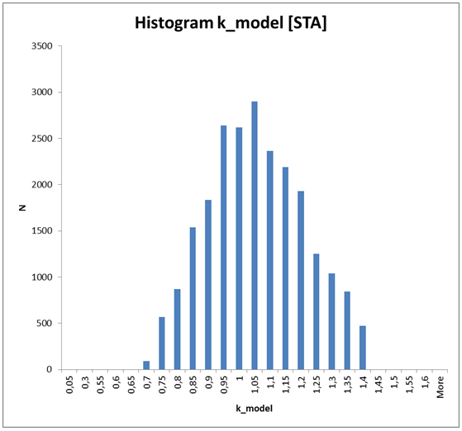
Quality controle
k - aparments
MEDIAN: 1,03
AVG 1,04
STDEV 0,16
11
11
Notes:
11

Slide 12
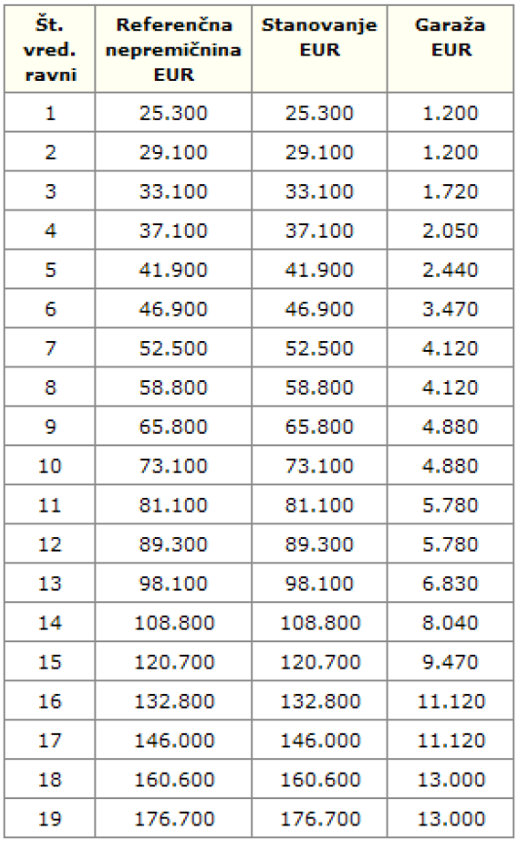
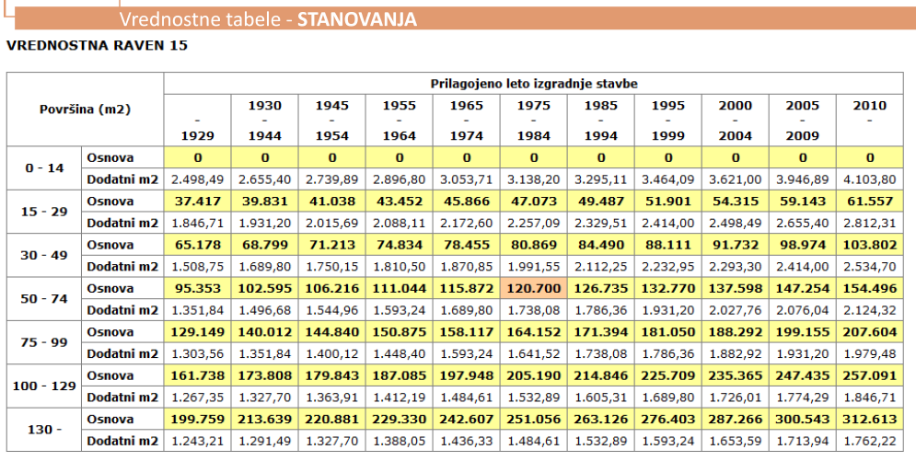
Presentation of models:
formulas transformed in value zones and value tables (case for apartments)
12
Notes:
Za kvalitetno izvajanje teh nalog potrebujemo kvalitetne podatke o trgu nepremičnin.
12

Slide 13
Implementing Mass Valuation
Development of first models took three years
From January 2012 valuation models are approved by the Government
In 2012 Generalized Market Value (GMV) was annotated to all real estate (6,5 million) in real property register
Two revaluations: in 2014 and 2015
Total value for all real estates in Slovenia is estimated on 120 billion EUR (60 % of wich are residential properties)

Slide 14
Attempt of introducing Real property tax in 2014
Taxing all properties (only few exemptions)
Due to economic and fiscal crisis the law proposal followed the idea to rise the revenue for 100 % due to including all real estates in taxation:
- leaving the tax on business real estate at the existing average (0,7 %)
- raising the tax for residential properties (twice of average effective tax rate 0,08 %)
- redirect half of the revenue to the state budget, leaving to the municipalities same revenue as in a previous system.
Real Property Tax Act was adopted in a Parliament at the end of 2013 and was introduced with 1. 1. 2014.

Slide 15
Constitutional court decision (March 2014)
Real Property Tax Act is to be abolished due to:
Setting the tax base on GMV, which is determined by unconstitutional solutions in Real Property Mass Valuation Act
Setting different rates by unfounded criteria
Not possible to appeal to all elements of the valuation
Mass valuation should not be used for taxes:
Too many solutions in the implementing regulation and not in the law (legal uncertainty)
The possibility of the owner to argue and influence the value is limited

Slide 16
Use of Mass Valuation
By the law Mass valuation system is intended for tax and other public purposes defined by law – GMV is publicly available
By the decision of Constitutional court GMV can not be used for taxation
Current public use:
- For assessing the wealth of the applicants for different social benefits
- In statistical analyses (calculating housing index, monitoring land price index, in calculating GDP etc.)
- For expropriation (compulsory purchase) and land consolidation in public interest (upgrading methodology which includes individual valuers)
Private use:
- Banks – recommended by The National Bank (for setting the mortgage credit value, for assessing the capital adequacy …)
- The Courts
- Notaries
- Appraisers
- Individuals …
Broad use of collected market data which are also publicly available

Slide 17
Actions for improving the situation
Slovenia asked IMF for revision of mass valuation system (the result shows that the system is internationally comparative and of high quality)
We are trying to increase the understanding and acceptance of mass valuation (workshops, establishment of professional body to monitor and verification of the system etc.)
We are preparing new mass valuation law:
- preserving the system as independent and multipurpose (promp adapting to the market)
- putting all relevant content in the law (Slovenian standard for mass valuation)
- increasing legal security by adding possibility to argue the value in a case of special circumstances
- strengthening the control over data in the registers

Slide 18
Recommendations
Develop a system with full cooperation of all involved institutions and with wide professional consesus (mass and individual valuation are complementary!).
Prepare concisely legal base (standardization, unification)
Try to establish mass valuation system as multipurpose and of high quality (data, models, up to date etc.), which will:
- reduce marginal costs
- widen the scope of use (more cost effective)
- ensure the additional quality control.
I WISH GREAT SUCCESS TO YOUR PROJECT!

