Slide 1
Property Valuation Workshop
General Directorate of Land Registry and Cadastre (TKGM; Tapu ve Kadastro Genel Müdürlüğü)
27 February - 2 March, 2017, İzmir, Turkey
The Lithuania State Land Cadastre and Register and the Development of Property Taxation
Albina Aleksiene, MRICS
State Enterprise Centre of Registers, Lithuania

Slide 2
Development of Land Administration in Lithuania
2005-2017
Integrated digital data of Cadastre, GIS, register
Data of Cadastre and register from CDB have legal power.
Digital survey equipment
Public access to data and services
Registers and cadastral data merged with municipal data to create context for new services and solutions (REGIA)
Digital notarized property transaction (NETSVEP)
Drones about to be deployed for greater surveying speed and accuracy
New land parcels are formed online on live cadastral map (Geo-surveyor application of CoR)
Open data
Paper files (BTI)
Topographical map
Separate formation and registration of Land and Constructions
Analog survey equipment
Limited public data
1997-2004
1990-1996

Slide 3
Development of Real Property Mass Valuation System
Introduction of land tax
Introduction of property tax;
Law on Real Property Register (1996)
Introduction of market value -based immovable property tax
Introduction of market value -based land tax
1998
2002
2006
2013
2005
1992
1995
Transactions data base established and start of mass valuation methodology development
First land mass valuation;
annual revaluation; use of values for public needs; started formation of legal basis of property taxes and mass valuation
First immovable property mass valuation, annual revaluation since,
use of values for public needs
Development of taxable values appeals system
Completed formation of legal basis of property taxes and mass valuation
Notes:
The reason for establishment of mass valuation system in Lithuania was a shift of land and real property taxes from normative values to based on market value.
Centre of Registers was entitled to assess market values of land and structures by law. Crucial moment and essential condition for further development of the mass valuation system in Lithuania was establishment of RE Register in 1996 and transaction data base in 1998. In the beginning, the land mass valuation was carried out in 2002, though results were used for non-taxation purposes only. Later in 2005 real property tax law changes occurred and mass valuation was conducted for structures. Following essential land tax reform in 2013 mass valuation of land was carried out for taxation purposes. Also it meant completion of the formation of legal base for both tax and mass valuation regulation in Lithuania.
Reasons for the shift to market based values in Lithuania: tax was uneconomic – average administrative costs were greater than average tax revenues?

Slide 4
Legal Regulation and Methodical Guidance
Laws on taxes
Law on Land Tax (1992, 2011)
Methodical guidance
Standards
International Valuation Standards
Law on Immovable Property Tax (1994, 2006)
Rules of Land Mass Valuation (2002, 2012)
In total over 35 legal acts, regulating valuation procedures and the use of mass valuation results.
European Valuation Standards
Mass Valuation Standards by IAAO
Law on Valuation Fundamentals of Property and Business (1999, 2012)
Rules of Immovable Property Valuation (2005, 2011)

Slide 5
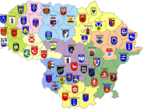
Main Stakeholders of Property Taxation and Mass Valuation System
Ministry of Finance
Budget, planning, research, analysis;
Approval of mass valuation results of buildings.
Data management;
Data analysis;
Property valuation;
Provision of data to the Tax Inspectorate, state institutions, public;
Investigation of appeals.
Municipalities
Setting the tax rate (within the limits set by laws);
Receipt of property tax revenue;
Reviewing of draft mass valuation documents;
Use of mass valuation results for social support and other issues.
Data on taxable property and taxpayers;
Tax collection and enforcement.
Ministry of Agriculture
Approval of mass valuation results
of land;
Control of abandoned lands;
Lease and sale of the state-owned land;
Land statistics.
Other users:
Land & immovable property tax payers;
Ministry of Justice;
Ministry of Environment;
Ministry of Social Security and Labour;
The Bank of Lithuania ;
Department of Statistics;
Notaries etc.

Slide 6
Main Characteristics of Property Taxes in Lithuania
 | Land Tax | Immovable Property (Building) Tax
Introduced | 2013 | 2006
Taxpayers | The owners of land (legal and natural persons) | The owners or users of taxable imovable property
Tax object | Private owned land | Immovable property used in commercial and economic activity.
Tax base | Market value of the land (mass valuation) | Market value of the building (mass valuation), value estimated by cost approach – engineering structures and industrial properties.
Tax rate | From 0.01 to 4 % in the Law (abandoned agricultural land can be taxed at the highest rate) | 0.3- 3% , property belonging to physical persons valued more than €220,000 is taxed at 1 % .
Tax rate determination | Determined annually by municipalities
Tax revenue is levied | To the budgets of municipalities

Slide 7
Main Characteristics of Property Taxes in Lithuania
 | Land Tax | Immovable Property (Building) Tax
Number of municipalities | 60
Valuation | State Enterprise Centre of Tax Registers
Tax administration | Tax Inspectorate
Main exemptions | publicly used roads; forestry land; land containing historical, cultural, nature monuments and parks; land of embassies; individuals of 0 - 40 % working capacity, individuals at the retirement age and young children, if there are no persons capable to work in the families. municipalities are entitled to reduce the tax at the expense of their budget or completely exempt from the payment; | state-owned or municipal real property ; real property of embassies, real property of churches, charitable organizations; real property used for education, science, cultural activities, social, environmental purposes; real property owned by companies registered in the free economics zones, agricultural and insolvent companies; the structures, which have not been acknowledged as suitable for use (unfinished buildings), where they are not actually used.

Slide 8
A Part of Immovable Property Tax in Municipality Budget

Slide 9
A Part of Land Tax in Municipality Budget

Slide 10
Shifting to Market Based Values (Structures - 2006)
Appeals:
2006 – 1335 reports;
2011 – 247 reports;
2016 – 30 reports.

Slide 11
Shifting To Market Based Values (Land - 2013)
Appeals:
2013 – 28 reports
2014 – 4 reports
2015 – 4 reports
2016 – 5 reports
(4-year transition period to reduce taxable value)

Slide 12
State Enterprise Centre of Registers
REAL PROPERTY
REGISTER
Centre of Registers is managed by the Ministry of Justice;
The enterprise is funded by the users of its provided services, from the State budget (~ 2 %) received only from the services ordered by the State;
Total number of employees at the Centre of Registers – over 1600, including over 90 IT specialists;
The integration of registers is currently ongoing.
Mass valuation is performed by 40 valuers and market analysts + 30 part time speacialists of cadastre, IT and GIS,
Valuers qualification – university degree + valuers certificate (general requirements) + knowledge of cadastre, GIS, statistical analysis, NCSS program.
from 1998
REGISTER OF
LEGAL ENTITIES
from 2004
ADDRESS
REGISTER
from 2004
POPULATION REGISTER
from 2014
Mortgage
From 2016

Slide 13
Data for Mass Valuation
Data Sources
Sales & lease transactions in Sales Database
(since 1998 over 2 mln transactions)
Real Property Register & Cadastre Database
(~2,5 mln land plots & ~3.9 mln constructions)
Location in Address Register & GIS maps (~1.8 mln addresses)
Classification
Property types (5 types of land, 10 types of constructions)
Value zones (~1200 actual & all historical)
Valuation models, coefficients (~1000 actual & all historical)
Assessment results
Estimated values (10 mln actual & all historical values)

Slide 14
Sales Data Collection
How is the market data collected?
Data about transaction comes from the notary offices through the Internet within 24 h after the approval of real property transaction (NETSVEP - Public Electronic Service for Real Property Transactions );
Sales & lease data are entered upon the registration of owner’s rights;
Additional information about lease is collected in public space.
Sales database is updated daily.

Slide 15
Mass Valuation Process (1 year)
Analysis of market data;
Setting of value zones;
Specification of models; The process consists of selecting an appropriate functional form for the model and choosing which variables to include.
Calibration of models; the process of adjustment of the model parameters
Verification of models.
Preparation of documents, public discussion, confirming.
Assessment of properties.

Slide 16
Public Review and Appeals
Public review:
Publication of the preliminary values of land and buildings in the Internet.
Public announcement of the start of public review of Mass valuation documents.
Documentation for Municipalities.
Correction of mistakes in Mass valuation documents.
Appeals:
Period: I quarter of the year, annually; Criteria: Individual valuation report;
Institutions:
1 step – Centre of Registers (Appeals Commission), Institution of Supervision of Property Valuation;
2 step – County Administrative Court;
3 step – Supreme Administrative Court.

Slide 17
Statistics of Appeals

Slide 18
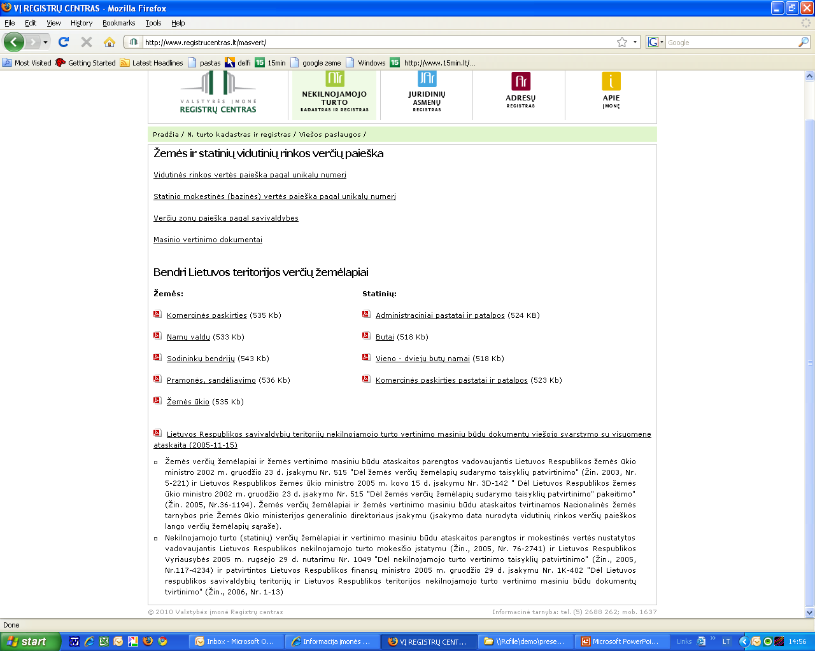
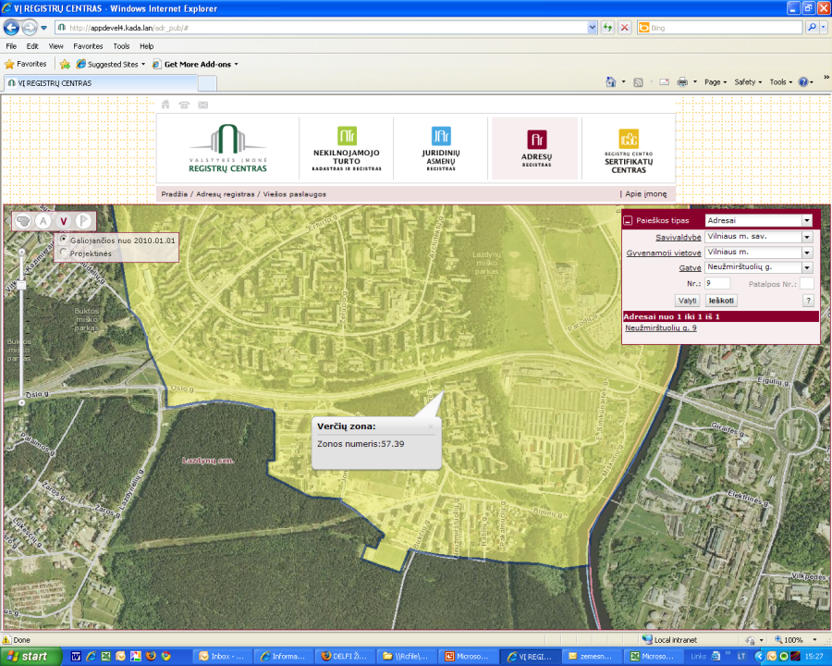
Publication of Mass Valuation Results on the Internet (Open for Public)
TEXTUAL DATA
Search for the average market value by unique number;
Search for the taxable (base) value of the building by unique number;
Search for value zones by municipalities, residential areas, streets;
Mass valuation documents, materials of public discussions.
GRAPHICAL DATA
Value maps of the territory of Lithuania;
Graphical search for value zones (through the Address Register).
DATA FOR THE REGISTERED USERS
Actual average market values on the search day (by price change coefficient).

Slide 19
Visualisation of the Data from the Registers
Data from the Register of Legal Entities and Real Property Register is visualized in the Regional geo-information environment service (REGIA). REGIA is based on the cadastral map of Lithuania, with its built-in three main state registers: Address, Legal Entities and Real Property, data, including valuation data

Slide 20
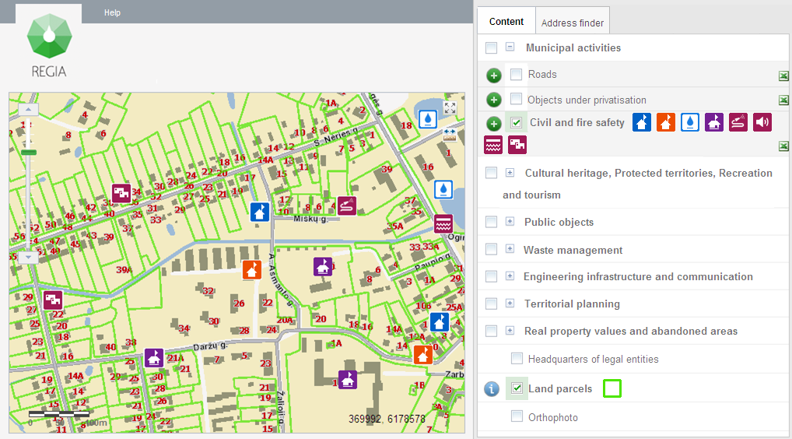
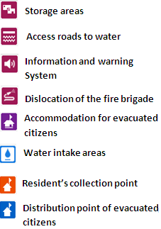
REGIA Service Administrator Environment
Within its managed data layer, the administrator can store and manage own data, information or documents, create and provide services based on geo-referenced data.

Slide 21
Use of Real Property Mass Valuation Data and Values
Assessment of taxable values of land and buildings
Providing of social support for low income citizens
Estimation of initial sales or rental value of state-owned land and buildings
Banks activities, estimation of statistical indexes
Calculation of notaries fees, real property registration fees, etc
For other state economic needs (estimation of losses, compensation, etc.)

Slide 22
Main Features of Mass Valuation System
Mass valuation of land and structures (buildings) are separate, accordingly with the separate land and buildings taxes. Property assessment is computerized and performed automatically, daily assessment of new properties is conducted.
Mass valuation is centralized and performed by the Centre of Registers
Valuation documents (value maps and reports (61 X 2)) are approved by the Ministry of Finance (structures), the National Land Service (land).
Three level appeal system is developed.
Values, assessed by mass valuation are used for different purposes – public needs.
Given the fact of multipurpose use of mass appraisal outcome, all real property (land and buildings) is revaluated annually, regardless of whether the property is subject to tax.
Lithuanian mass valuation system was presented in different international events, articles, international projects (China, Russia, Azerbaijan, Egypt, CEE countries, etc.)

Slide 23
Thank You For Attention

